Slide 1

DSCI 4520: Final Project
Using Classification Models to Predict Telecommunications Customer Churn
AMARILIZ MARTINEZ
JORDYN SILVERS
MIA KERR
SILVANA PIERCE

Slide 2
Contributions
Mia Kerr – Data Preparation and Modeling, Findings
Amariliz Martinez – Project Coordinator, Data Description
Jordyn Silvers – Executive Summary
Silvana Pierce – Business Recommendations and Conclusion

Slide 3
Executive Summary
Our project focuses on customer churn in the telecommunications industry, a critical business challenge as keeping a current customer is cheaper than trying to sign a new one. Using a dataset of over 7,000 IBM customers, we prepared the data in AI Studio using mode imputation and one-hot encoding to ensure model accuracy. We then evaluated project performance using both Logistic Regression and Decision Trees.
The Logistic Regression model was our top performer, hitting 79.18% accuracy and 72.38% sensitivity. Our analysis identified the number of dependents as the strongest predictor of loyalty, while month-to-month contracts and fiber optic service were the primary drivers of churn. These findings give the company a specific roadmap for success. By targeting high-risk groups with specialized promotions and offering family-focused incentives to those with dependents, the company can improve retention while protecting their recurring revenue.

Slide 4
Project Motivation + Background
This project was chosen because customer churn is a major challenge in the telecommunications industry. Gaining new customers usually costs more than keeping new ones, so identifying customers who may leave helps companies improve retention. Churn prediction is also a real- world business problem where data analytics can create measurable value.
This project is important because losing customers reduces recurring revenue and market share. Predicting churn allows companies to improve customer satisfaction, reduce cancellation rates, target high-risk customers with promotions or support, and increase long-term customer lifetime value (CLTV). Models like Logistic Regression and Decision Trees can support smarter retention decisions.

Slide 5
Data Description
We used telecom customer accounts and service data to classify whether a customer would churn or stay.
The main variable we focused on was Churn Value, which shows if a customer churned or remained. It was converted into a nominal classification variable.
The data set included useful customer details such as contract type, internet service, tenure, monthly and total charges, payment method, phone service, tech support, partner status, age, and customer lifetime value (CLTV).
We also created new variables to improve models, including number of dependents and services. These helped us better understand customer behavior and identify patterns related to churn.
Before building the models, the data was cleaned and prepared by converting categories into numerical values, removing unnecessary columns, and standardizing some variables for better accuracy.

Slide 6
Data Preparation
Before modeling, key demographic features such as number of dependents, marital status, etc., were selected from sub-tables and added to the dataset to capture additional, valuable relationships between the data. In turn, redundant and/or leaky features were removed (e.g., latitude/longitude, churn score)
No anomalies were detected, and the few missing values were handled using mode imputation via AI Studio
One-hot encoding was utilized for categorical features, and for the logistic regression model, continuous data were thereafter normalized using z-score transformations.
Some new features were created using the selected data, such as Low vs. High Services [in a customer's plan], but these were found to be insignificant in both models.
Backwards selection was utilized for feature selection in the logistic regression model following collinearity analysis.

Slide 7
Models Used
Logistic Regression
  A classification model used to evaluate the correlation between certain features (coefficients) in a dataset and the target variable (y)
  Allowed for deeper investigation of individual features within the dataset and their impact on churn
  Necessitated more care in modeling process (normalization, coefficient evaluation for collinearity, anomalies, etc.)
Decision Tree
  A classification model used to simulate the choice of a target variable based on the features of the data
  Allowed for faster processing at the cost of a deeper understanding of the data's features and their intercorrelation

Slide 8
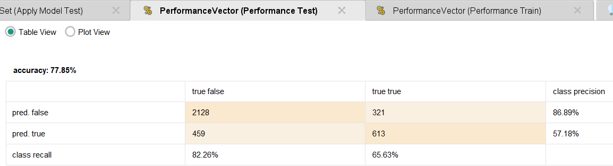
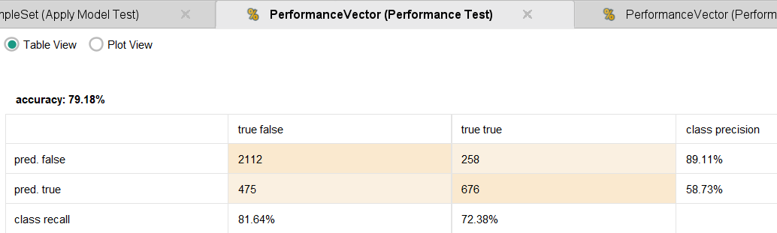
Findings - Comparative
Both models were closely matched in their testing accuracy, though logistic regression yielded slightly better results overall, testing with 79.18% accuracy vs. The decision tree's 77.85% testing accuracy
The sensitivity and specificity was far improved in the logistic regression model as well, with 72.38% sensitivity and 81.64% specificity; the decision tree tested with 65.63% sensitivity and 82.26% specificity
The logistic regression model was better suited overall, yielding better information on churn factors as well as providing improved accuracy without compromising its sensitivity nor specificity
DECISION TREE
LOGISTIC REGRESSION

Slide 9
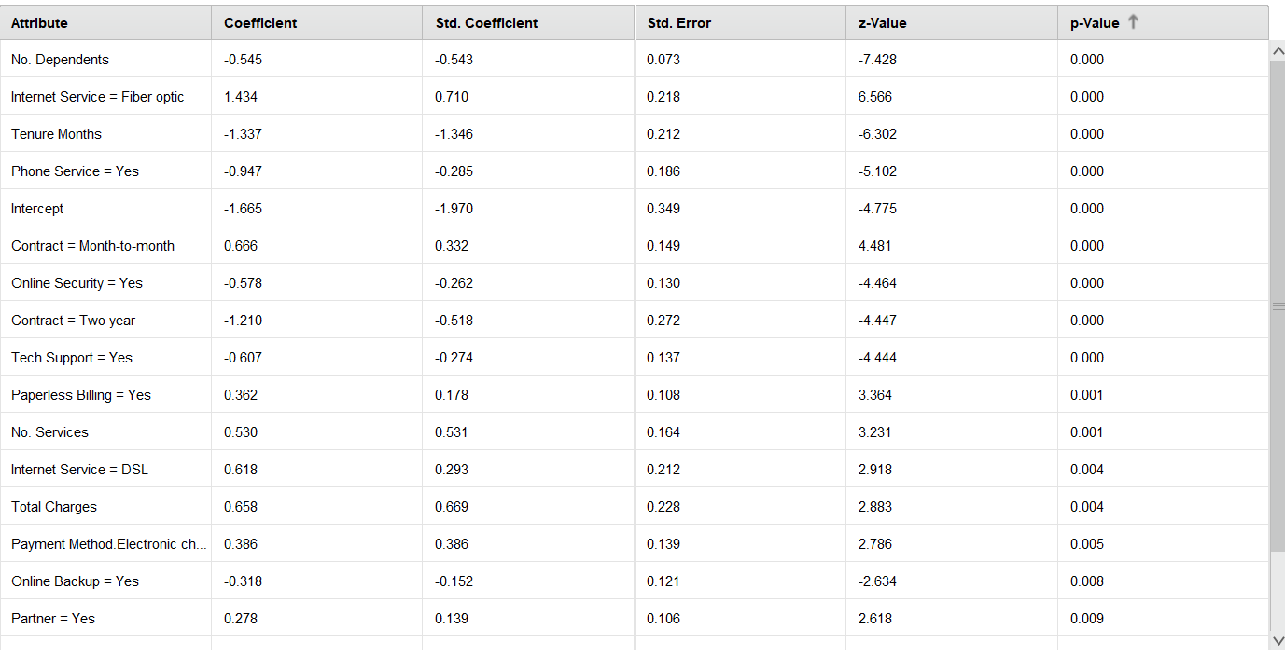
Findings – Logistic Regression
The single best predictor of churn was number of dependents, with a coefficient of –0.545; for every one unit increase in the customer's number of dependents, their likelihood of churning decreased
The second best was fiber optic internet service, which had a positive coefficient of 1.434; utilizing this service increased one's likelihood of churning by almost 1.5 points
Overall, features relating to the particular services a customer had/didn't have in their plan, and the conditions of their plan, correlated most strongly with their potential to churn. Demographic features (notably excluding no. dependents) were largely found to be irrelevant or at most statistically insignificant.
This model had slightly higher specificity than sensitivity during testing, with a 9.26 percent point difference.
STATISTICALLY SIGNIFICANT FEATURES

Slide 10
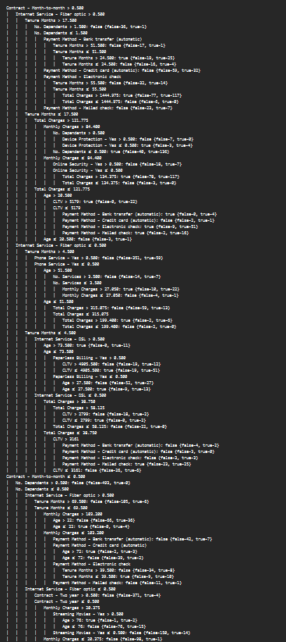
Findings – Decision Tree
The root node of the tree was a month-to-month contract, denoting this as the most significant determinant of a customer's potential to churn.
Fiber optic internet service was also, much like in the logistic regression model, found to be a key feature, as was tenure months (splitting on 4.5 months of tenure)
The decision tree had significantly higher specificity than sensitivity, with a 16.63 percentage point difference between the two in the testing model; this model "played it safe," prioritizing true churners versus falsely flagging customers as potential churners

Slide 11
Our findings tell us that:
Our recommendation:
Retain loyal customers with family-focused perks
Family Plans
Multi-line discounts
Priority customer service
Target non-dependent customers with
Incentives
Discounts
Improve fiber-optic experience by:
Analyzing customer complaints
Offer service guarantees
More outreach
Offer plans with more value to elevate customer experience by:
Bundle plans
Longer-term contracts
A: There is a negative relationship between number of dependents and churn. So, when dependents like kids & family members increases, likelihood of churning decreases.
B: Fiber optic experience had the biggest churn risk-factor
C: Service features and plan conditions are strongest predictors of churn

Slide 12

In Conclusion...
After running and analyzing both our linear regression and decision tree models, we found that they showed similar patterns that indicated that churn is most likely driven by the services that customers already use, and how those plans are structured, rather than personal demographics.
Customers with fewer dependents and also those using the fiber optic service were most likely to leave. By leveraging linear regression and decision tree models, we were able to validate these results and show how churn is driven by service-related and plan structure factors.
Focusing on improving our existing services, keeping our existing customers loyal, and strengthening customer care and attention is how the company can increase retention.

